Slide 1
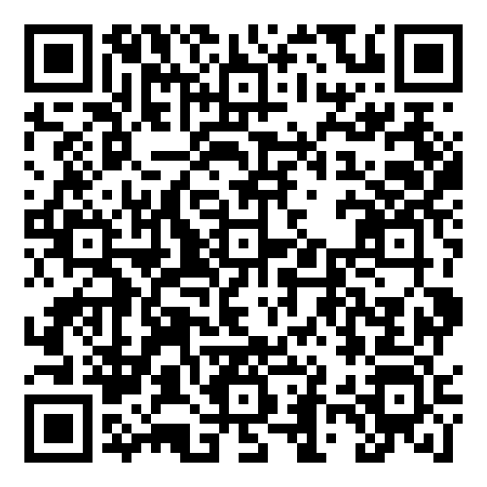
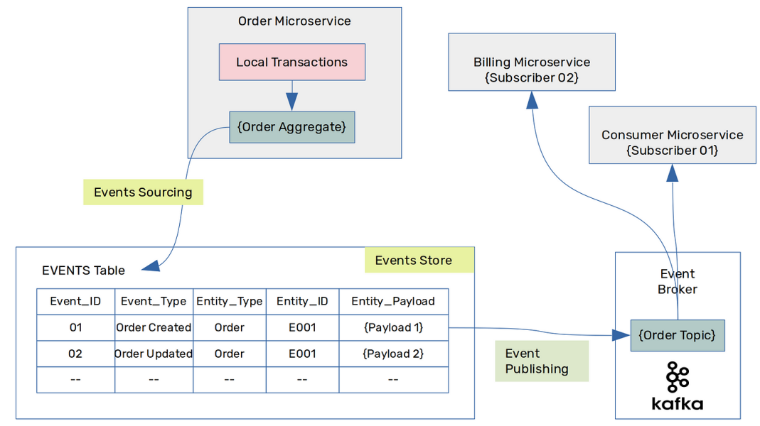
Lab 03 - Event Sourcing
https://bit.ly/4iSwZSR

